Slide 1


Anandi Guevara
13 Aug 2023

Slide 2

Outline
Executive Summary
Introduction
Methodology
Results
Conclusion
Appendix

Slide 3
Executive Summary
Summary of methodologies
Data Collection through REST API and webscraping
Data wrangling
Exploratory data analysis (EDA) using visualization and SQL
Interactive visual analytics using Folium and Plotly Dash
Predictive analysis using classification models
Summary of all results
Exploratory data analysis results
Interactive analytics demo in screenshots
Predictive analysis results

Slide 4
Introduction
Project background and context:
The commercial space age is here and companies are making space travel more affordable for everyone. SpaceX advertises Falcon 9 rocket launches on its website with a cost of 62 million dollars; other providers cost upwards of 165 million dollars each. Much of the savings is because SpaceX can sometimes recover and reuse the first stage. Therefore, if we can determine if the first stage will land, we can determine the cost of a launch. This information can be used if an alternate company wants to bid against SpaceX for a rocket launch as is the case with SpaceY.
Problems you want to find answers to:
Will SpaceX reuse the first stage? If so, can determine the price of each launch to be competitive.
What are the main factors influencing the success of a launch?

Slide 5

Section 1

Slide 6
Methodology
Executive Summary
Data collection methodology:
Data was collected through an open source SpaceX REST API and by webscraping HTML tables on Wiki pages
Perform data wrangling
Separated all landings_outcomes into successful vs unsuccessful. Used this information to generate a binary classification variable called landing_class.
Perform exploratory data analysis (EDA) using visualization and SQL
Perform interactive visual analytics using Folium and Plotly Dash
Perform predictive analysis using classification models
Standardized, transformed, and split data into train and test sets.
Trained each model & found the best hyperparameters.
Calcultated the accuracy of train and test data and constructed confusion matrices to evaluate the classification models.

Slide 7
Data Collection
Collected launch, rocket, core, capsule, starlink, launchpad and landing pad data through an open source SpaceX REST API and valuable Falcon 9 Launch records by webscraping HTML tables on Wiki pages with BeautifulSoup.
Both data collection methods involved the following high-level process steps:
Identify URL/endpoint to be used
Define helper functions
Perform GET request
Obtain response
Extract information
Use helper fxns to append data to list(s)
Create dictionary
Create dataframe from dictionary

Slide 8
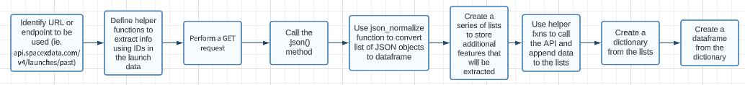
Data Collection – SpaceX API
Data was collected through the SpaceX API utilizing these steps:
You may access the SpaceX API calls notebook through this link:
https://github.com/aguevara1290/Capstone/blob/main/jupyter-labs-spacex-data-collection-api_AG.ipynb

Slide 9
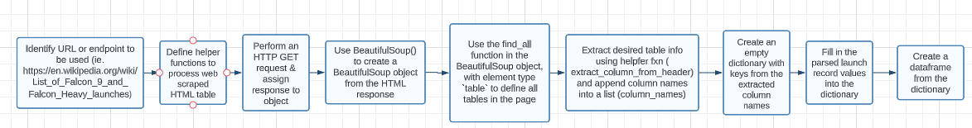
Data Collection - Scraping
An HTML table with launch records was web scraped using the following process steps:
You may access the web scraping notebook through this link:
https://github.com/aguevara1290/Capstone/blob/main/jupyter-labs-webscraping_AG.ipynb

Slide 10
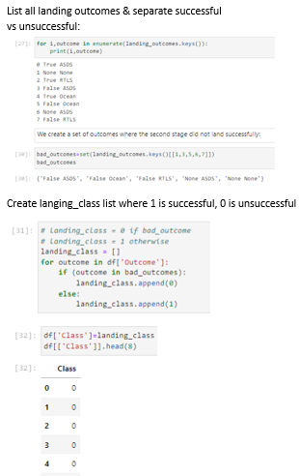
Data Wrangling
Data processed as follows:
Completed some basic data cleaning and EDA such as looking for missing values, data types, # of launches per site, count per orbit and count per landing outcome.
Created 2 sets of outcomes, separating successful vs unsuccessful landing outcomes. Used this to define a landing outcome label where 0 means unsuccessful and 1 means successful.
You may access the web scraping notebook through this link: https://github.com/aguevara1290/Capstone/blob/main/IBM-DS0321EN-SkillsNetwork_labs_module_1_L3_labs-jupyter-spacex-data_wrangling_jupyterlite.jupyterlite_AG.ipynb

Slide 11
EDA with Data Visualization
Charts plotted included a mix of scatterplots, barcharts and line graphs
Flight Number vs. Launch Site – to visualize relationship and understand patterns such as which sites have a higher and lower # of flights
Payload Mass vs. Launch Site – to identify the variance in rocket payload mass per site and determine if any sites launch lighter or heavier rockets.
Success % of each Orbit Type – to identify orbits with the highest & lowest landing success
FlightNumber vs Orbit Type – to determine if the # of flights within a specific orbit impacts the landing outcome
Payload vs. Orbit Type – to determine if heavy or lighter rockets have a better landing outcome within a specific orbit
Yearly Launch Success Trend – to visualize and spikes or falls in launch success over time
You may access the EDA with data visualization notebook through this link:
https://github.com/aguevara1290/Capstone/blob/main/IBM-DS0321EN-SkillsNetwork_labs_module_2_jupyter-labs-eda-dataviz.ipynb.jupyterlite-AG.ipynb

Slide 12
EDA with SQL
Performed the following SQL queries including subsqueries, group bys and commands such as sum, avg, min, distinct, day to obtain insights from the data.
All Launch Site Names
Launch Site Names Begin with 'CCA’
Total Payload Mass (kg)
Average Payload Mass by F9 v1.1
First Successful Ground Landing Date
Successful Drone Ship Landing with Payload between 4000 and 6000
Total Number of Successful and Failure Mission Outcomes
Boosters Carried Maximum Payload
2015 Launch Records
Rank Landing Outcomes Between 2010-06-04 and 2017-03-20
You may access the EDA with SQL notebook through this link:
https://github.com/aguevara1290/Capstone/blob/main/EDA%20with%20SQL.ipynb

Slide 13
Build an Interactive Map with Folium
Summary of map objects created and added to a folium map:
1. Marked all launch sites by creating a map object with an initial location (TX) and adding circles and markers to highlight location and show text label icons for each site.
2. Marked launch outcomes for each site by creating color-labeled markers for all launch records. If a launch was successful (class=1), then we used a green marker and if a launch was failed, we use a red marker (class=0)
3. Used mouse position and markers to define coordinates of points of interests such as railways, highways, costlines, etc. and drew polylines between launch sites and these new markers to calculate distances
Why added those objects:
1. Understand where launch sites are located
2. Understand which sites have high success rates
3. Understand if launch sites are in close proximity to railways, highways, coastline and cities.
You may access the folium notebook through this link:
https://github.com/aguevara1290/Capstone/blob/main/IBM-DS0321EN-SkillsNetwork_labs_module_3_lab_jupyter_launch_site_location.jupyterlite_AG.ipynb

Slide 14
Build a Dashboard with Plotly Dash
The following plots/graphs and interactions were added to the dashboard:
Successful Launches for all sites – to identify site with most & least successful landings
Successful launches for KSC LC-39A – to identify to success ratio of the site with the best outcomes
Payload vs Launch Outcome – to identify the booster with the largest success as well as the optimal payload range
You may access the dash notebook through this link:
https://github.com/aguevara1290/Capstone/blob/main/spacex_dash_app.py

Slide 15
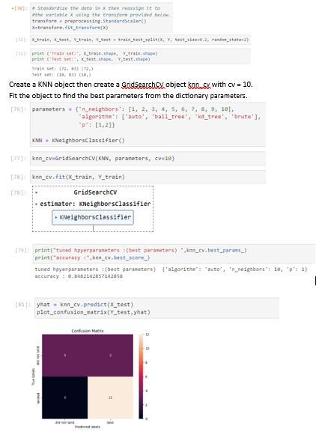
Predictive Analysis (Classification)
Summary of how built, evaluated, improved, and found the best performing classification model:
Loaded, standardized, transformed and separated the data into training and testing sets
Built objects for each classification model along with respective GridSearchCV objects which were used to train the models, find the optimal parameters, and calculate the accuracy of the validation and test data
Confusion matrices were created for each model to determine the performance of the classification algorithm. This was used in addition to accuracy calculations to identify the best performing model.
You may access the predictive analysis notebook through this link:
https://github.com/aguevara1290/Capstone/blob/main/IBM-DS0321EN-SkillsNetwork_labs_module_4_SpaceX_Machine_Learning_Prediction_Part_5.jupyterlite_AG.ipynb

Slide 16
Results
Exploratory data analysis results
Interactive analytics demo in screenshots
Predictive analysis results

Slide 17

Section 2

Slide 18
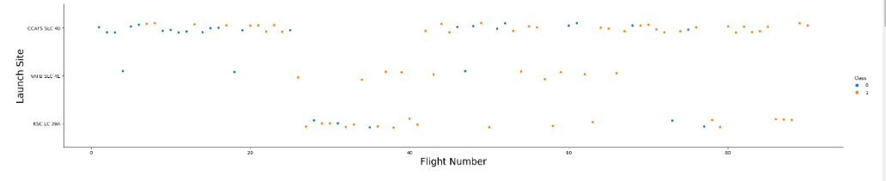
Flight Number vs. Launch Site
The scatter plot shows that as flights increase for CCAFS SLC-40 the # of successful landings increases.

Slide 19
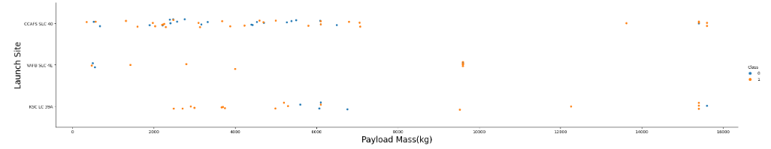
Payload vs. Launch Site
If you observe Payload Vs. Launch Site scatter point chart you will find for the VAFB-SLC launchsite there are no rockets launched for heavypayload mass (greater than 10000).

Slide 20
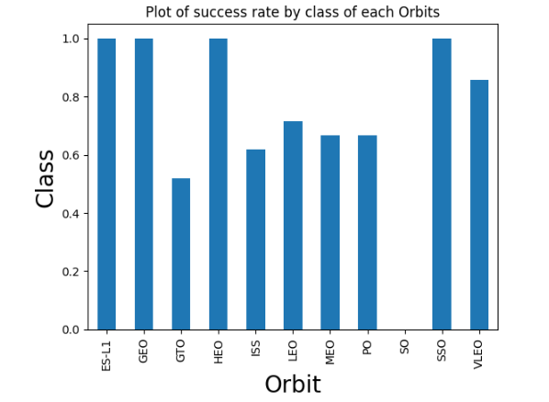
Success Rate vs. Orbit Type
Orbits with the highest sucess rate:
ES-L1, GEO, HEO, & SSO
Orbits with lowest success rate:
SO & GTO

Slide 21
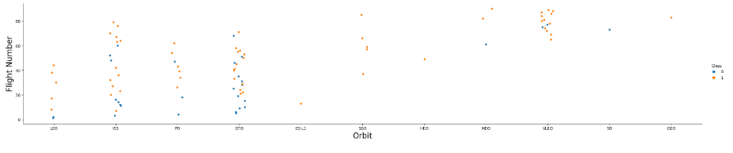
Flight Number vs. Orbit Type
You should see that in the LEO orbit the Success appears related to the number of flights; on the other hand, there seems to be no relationship between flight number when in GTO orbit.

Slide 22
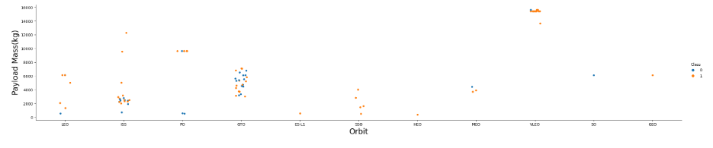
Payload vs. Orbit Type
With heavy payloads the successful landing or positive landing rate are more for Polar, LEO and ISS.
However, for GTO we cannot distinguish this well as both positive landing rate and negative landing (unsuccessful mission) are both there.

Slide 23
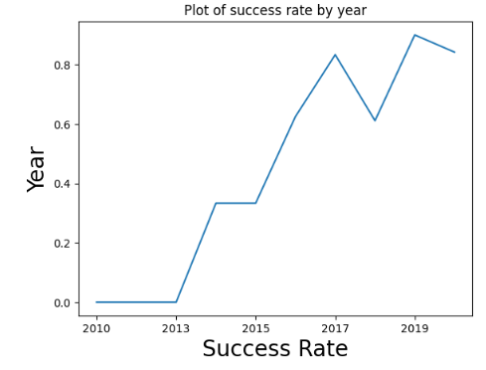
Launch Success Yearly Trend
You can observe that the sucess rate since 2013 kept increasing till 2020

Slide 24
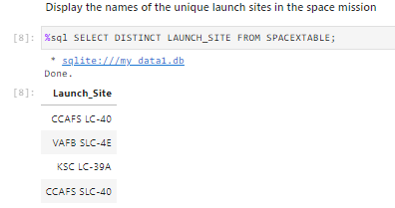
All Launch Site Names
The following are the names of all the unique sites the rockets are launched from. One of the sites (VAFB SLC-4E) is in California. The other 3 are in Florida.
The information was retrieved using the DISTINCT command

Slide 25
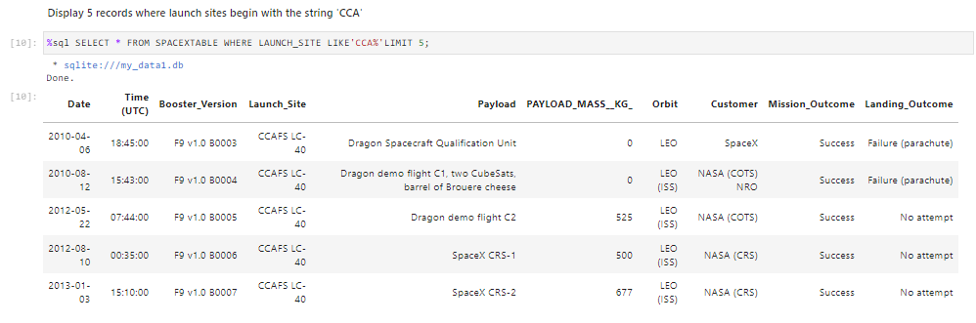
Launch Site Names Begin with 'CCA'
The list represents the first 5 rows of records for launch sites beginning with `CCA. It includes CCAFS LC-40 launches from 2010-2013 with different booster versions and varying landing outcome results.
The rows where retrieved using WHERE, %, and LIMIT commands
string pattern (‘CCA’) and wild card character (%)

Slide 26
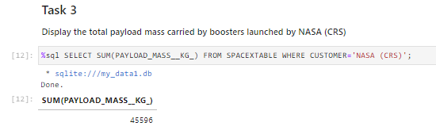
Total Payload Mass
The following is the total payload carried by boosters from NASA
The value was calculated making use the the SUM function and WHERE command

Slide 27
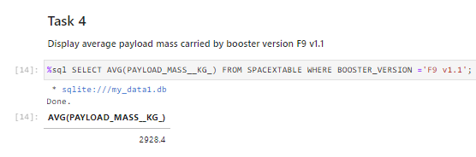
Average Payload Mass by F9 v1.1
Below is the average payload mass carried by booster version F9 v1.1
The value was calculated using the AVG function and WHERE command

Slide 28
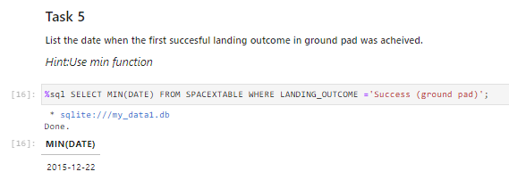
First Successful Ground Landing Date
Below are the dates of the first successful landing outcome on ground pad
The date was calculated using the MIN function and WHERE command

Slide 29
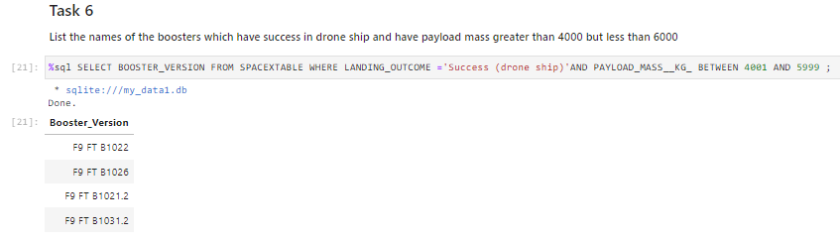
Successful Drone Ship Landing with Payload between 4000 and 6000
Boosters which have successfully landed on drone ship and had payload mass greater than 4000 but less than 6000 are as follows:
Rows were retrieved using the WHERE, AND, and RANGE commands

Slide 30
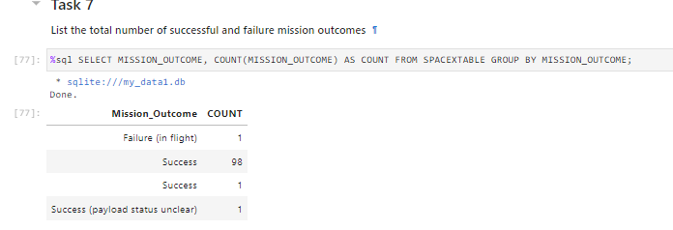
Total Number of Successful and Failure Mission Outcomes
The total # of successful and failure mission outcomes is shown below:
The outcome count was calculated using the AS COUNT command and GROUP BY clause

Slide 31
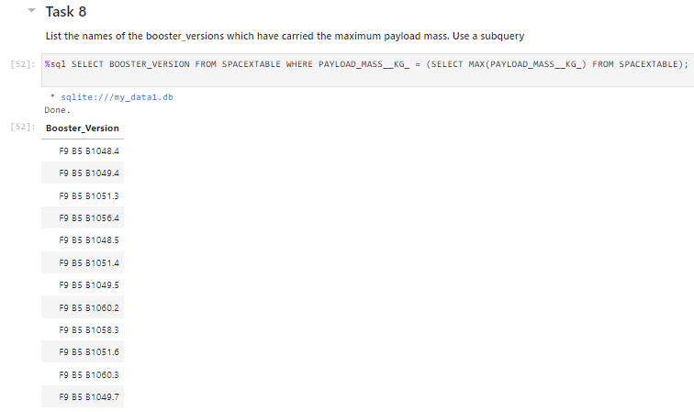
Boosters Carried Maximum Payload
The names of the boosters which have carried the maximum payload mass can be seen below:
Rows were retrieved using a subquery which makes use of a max function and WHERE command

Slide 32
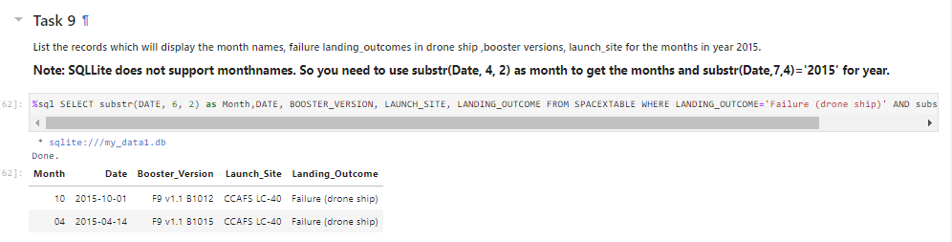
2015 Launch Records
The failed landing_outcomes in drone ship, their booster versions, and launch site names for 2015 are shown below:
The month value was calculated using the SUBSTR function while all other rows were retrieved using the WHERE & AND commands

Slide 33
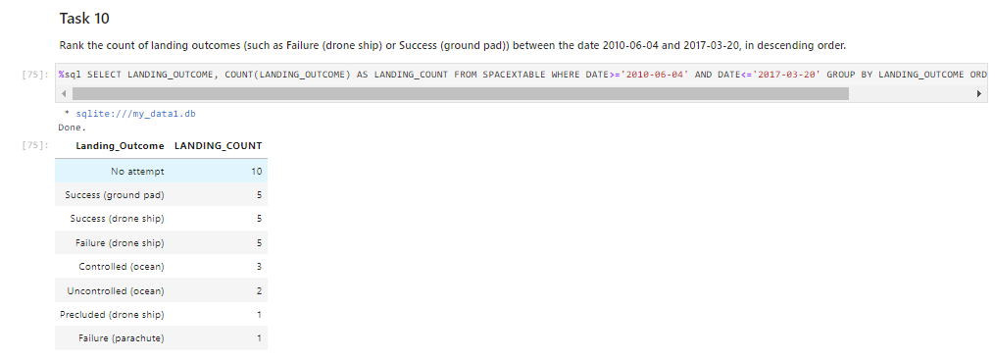
Rank Landing Outcomes Between 2010-06-04 and 2017-03-20
The following is a ranked list (desc) of landing outcomes (such as Failure (drone ship) or Success (ground pad)) between the dates of 2010-06-04 and 2017-03-20.
Rows were retrieved using WHERE & AND commands as well as a GROUP BY clause
An ORDER BY clause and a DESC command were used to rank the results in descending order

Slide 34

Section 3

Slide 35
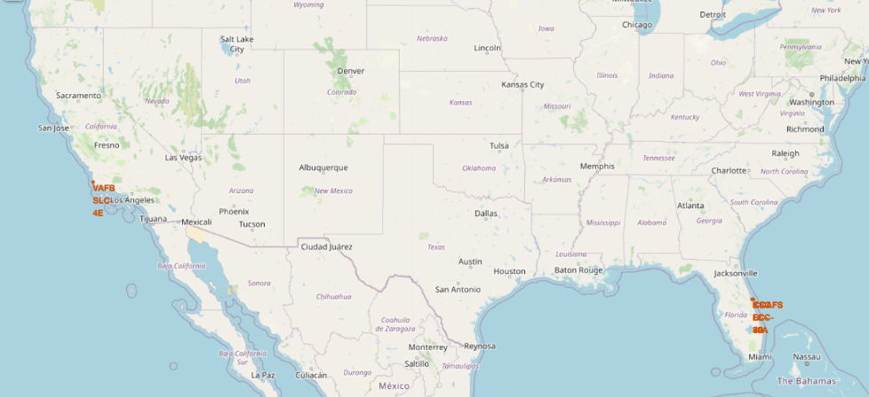
Location of Launch Sites
Important elements and findings on the screenshot:
All sites are in the US, above the equator line, and in close proximity to the coast

Slide 36
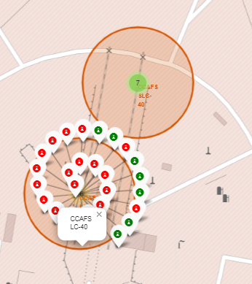
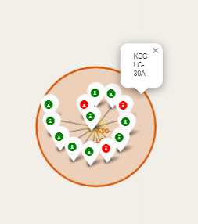
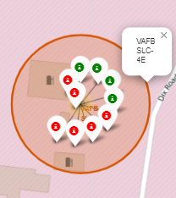
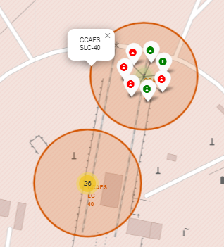
Launch Outcomes for Each Site
Key insights include:
Lanches only happen in 1 of 4 sites
1 site is in California; the other 3 within short distance of each other in Florida
The site with the most launches is CCAF LC-40
The site with the most visible successes is KSC LC-39A

Slide 37
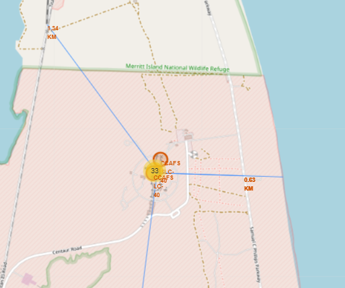
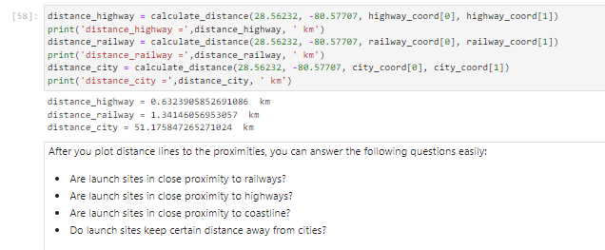
Launch Site Distance to Points of Interest
Through this exercise one can observe that launch sites are:
In close proximity to railways, highways, and coastlines
Far from cities

Slide 38

Section 4

Slide 39
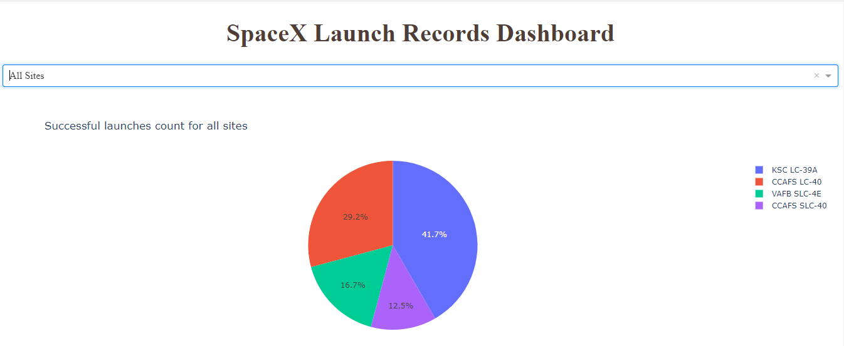
Successful Launches for all sites
The site with the highest % of successful launches is KSC LC-39A (41.7%) followed by CCAFS LC-40 (29.2%)
Together these 2 sites make up ~70% of successful launches

Slide 40
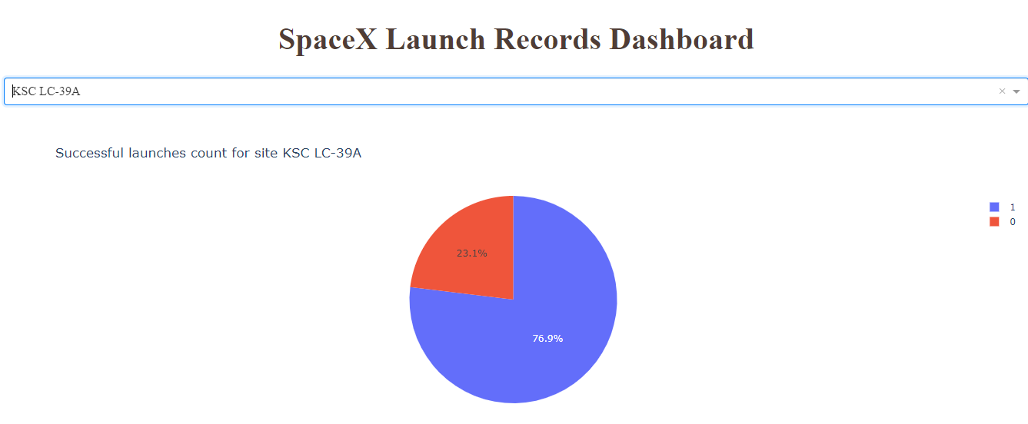
Successful launches for KSC LC-39A
KSC LC-39A is the site with highest launch success ratio, where nearly 80% of launches have been successful! (only 3 unsuccessful landings out of 13 attempts)

Slide 41
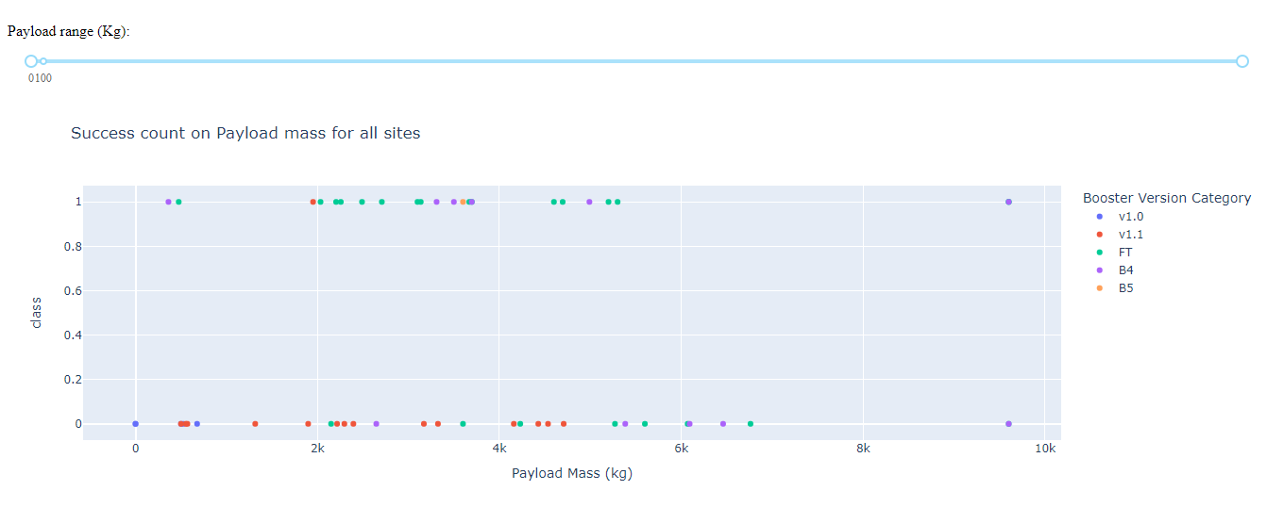
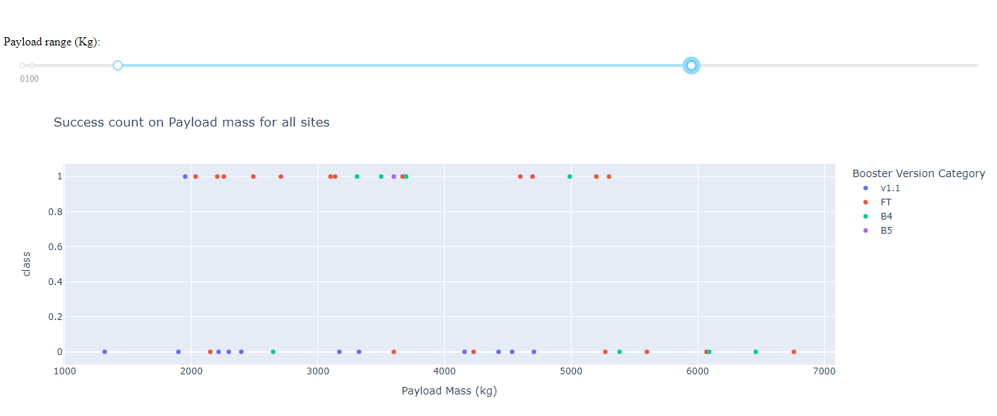
Payload vs. Launch Outcome
Payload range 0-10k (kg)
Payload range 1-7k (kg)
Key findings:
Payload range with largest success rate: 1.9k – 5.3k (kg)
Above this range only 1 successful at 9.6kg (B4 Booster)
Booster version with largest success: FT
Booster version with least success: v1.1
Regardless of payload

Slide 42

Section 5

Slide 43
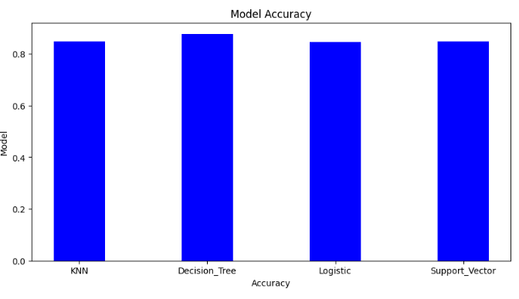
Classification Accuracy
The decision tree model has the highest classification accuracy of all evaluated models at 87%

Slide 44
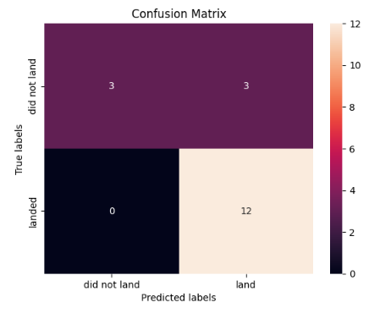
Confusion Matrix
The decision tree model confusion matrix shows that, for the most part, the algorithm is able to distinguish between “landed” & “did not land”. The major problem here is false positives.

Slide 45
Conclusions
To conclude:
# of flights has a positive correlation to landing success
Orbits with the highest sucess rate are ES-L1, GEO, HEO, & SSO
Success rate has been improving since 2013
All launch sites are in the US, above the equator line, and in close proximity to the coast, highways and railways
The site with highest success rate is KSC LC-39A (80% success)
Payload range with largest success rate: 1.9k – 5.3k (kg)
Booster version with largest success: FT
The best classification model for this application is the Decision Tree Model (87% accuracy)

Slide 46


